Slide 1



Healthcare Innovation and Investment
in Upstate’s Aging Population
Upstate Entrepreneurship Ecosystem Data Series
Sydney Scaccia
This research was made possible through the generosity of the

Slide 2
THE BASICS

Slide 3
Connecting Geography
To Innovation and Investment
Within the aging population, three fourths of older adults prefer to live in their homes for as long as possible, opening the door to investors and small businesses to create and fund these services to comply with the customer's needs.
New York State appears to be promising for healthcare startups, however, making the connection between sales success and geographical location, at least statistically, means more attention may be needed to elevate new entrants into the market.
Source: Crunchbase

Slide 4

Revolutionizing patient monitoring for future remote healthcare.
Driven by our contact-free biomarkers sensing technology.

Slide 5

Accelerating Factors/Upstate New York
Artificial
Intelligence
Telehealth/
Pandemic
Aging
Population
Example: Northwell Health's research arm developed a tool that can determine whether a patient needs to be woken up in the middle of the night.
How will this impact public health, workforce redeployment, and virtual collaborative learning networks?
The U.S. Census Bureau projects that by 2030, 20.8 percent of upstate New York’s population will be aged 65 and over.
Sources: Inc.; Centers for Disease Control and Prevention; U.S. Census Bureau

Slide 6
New York Regions
Health Care Sectors
Which are in stronger position to support innovation and investment?
The research aimed to uncover connections between healthcare businesses throughout Upstate New York and their sales potential.

Slide 7
THE DATA

Slide 8
Metropolitan Statistical
Areas (MSAs)
01
Buffalo
05
Utica-Rome
Rochester
Binghamton
02
06
Albany-Troy-
Schenectady
07
Poughkeepsie-Newburgh-Middletown
03
The Importance of Geography
04
Syracuse
Source: BizMiner/financial and market analysis company

Slide 9
The NAICS Data
621
622
623
02
Ambulatory
Hospitals
Nursing Facilities
Note: Throughout the analysis, the NAICS codes were used in the algorithm to determine if the type of business had an impact on the location and sales potential.

Slide 10
Methodology
3,584
20
4
Healthcare Businesses
Sales Brackets
Clusters
The number of healthcare-related businesses across seven MSAs.
The analysis also included the businesses sales bracket, their per capita, and NAICS code. There are 20 total sales brackets ranging from $1-$500 million.
The brackets were then divided into four clusters containing five brackets each to avoid skewness.
Source: BizMiner/financial and market analysis company

Slide 11
Sales Clusters
01
$1-$3.99 million
02
$4-$19.99 million
Categorical Values
03
$20-$74.99 million
04
$75-$500 million
Note: Including the NAICS variable helped differentiate the sales brackets of hospitals and ambulatory healthcare businesses since there is a large gap between $1 million and $100 million.
Source: BizMiner/financial and market analysis company

Slide 12
RESULTS & FINDINGS

Slide 13
Classification Algorithms
Correctly classified new businesses 83 percent of the time by taking into account the sales cluster, NAICS code, businesses type, and MSA regional per capita.
83%
7
11.25
Accuracy
Sales Potential
Standardizing the Data
Meaning: There is a higher reward than loss to invest in the predicted healthcare businesses.
The algorithm aids in the prediction of sales potential within seven MSAs for the upcoming year based on three variables.
The per capita for each MSA standardized the population because of extremes (Buffalo per capita 11.25/Binghamton per capita 2.37.)
.

Slide 14
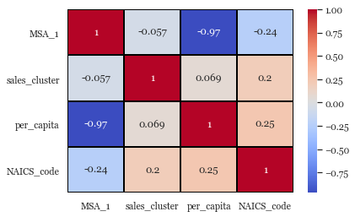
Results: Relationships/MSAs and Clusters
A unique finding was the relationship between the sales clusters and the MSAs.
These variables had a negative correlation of -.057 which is statistically a very weak relationship. This is to be expected because within the sales clusters, there is a major difference in a business generating $20 million and $74.99 million within a year.
Eighty three percent of the businesses included within this analysis lie within the first sales cluster which ranges from $1-$3.99 million which could skew this relationship.

Slide 15
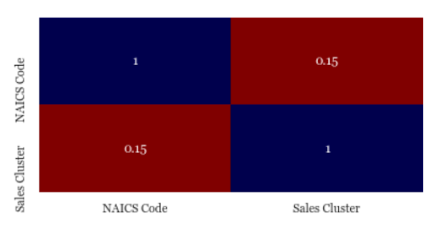
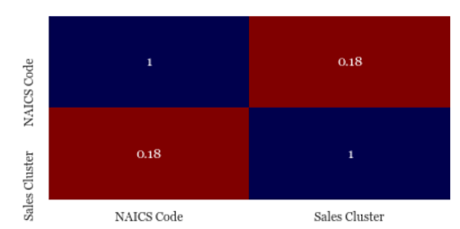
Need for Investment in Three MSAs
The low correlation between the NAICS code and the sales cluster signals to investors that there is a need for innovation and investment within each MSA.
Rochester
The low correlation between NAICS codes and sales clusters shows that there is a low-risk benefit to investing in this market.
Weak correlations show there is opportunities for growth in the MSAs with the lowest correlation.
To investors, the three lowest correlation MSAs are areas in need of innovation and investment to keep up with other areas throughout Upstate.
Utica/Rome
Albany-Troy-Schenectady

Slide 16
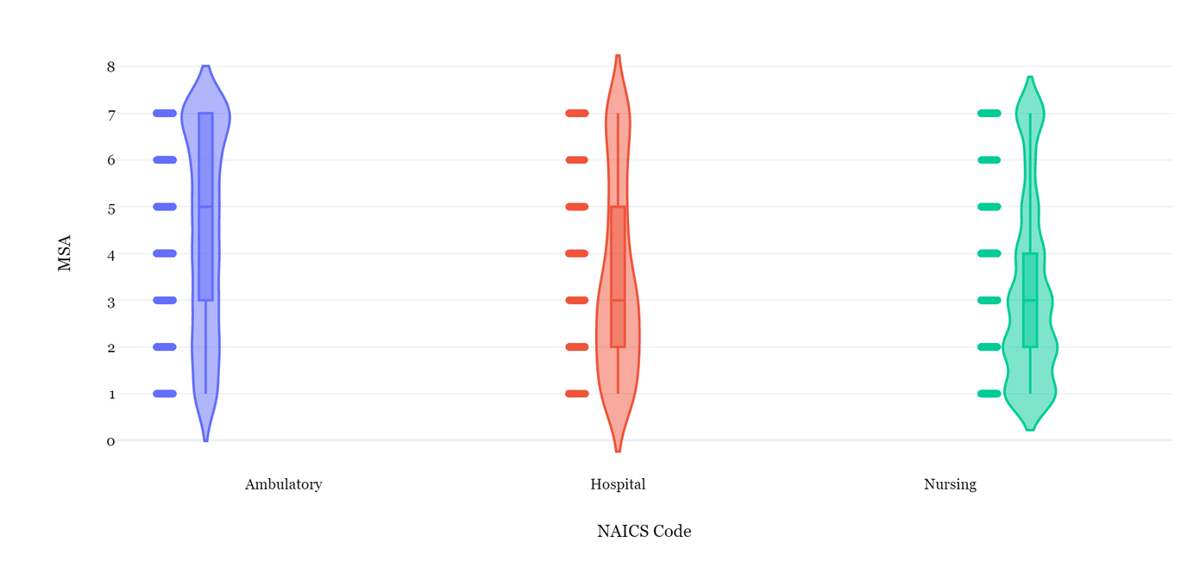
Prime for Aging-Related Startups & Innovation
P-N-M
Binghamton
Utica/Rome
Syracuse
A-T-S
Rochester
Buffalo
NAICS code 623: Nursing & Residential Care Facilities
NAICS code 623 has an average that lies on Albany-Troy-Schenectady, however, the widest areas on the plot lie at Buffalo, Rochester, and Poughkeepsie-Newburgh-Middletown. This means that these MSAs have the largest number of businesses, but are falling behind when it comes to investment and innovation.

Slide 17
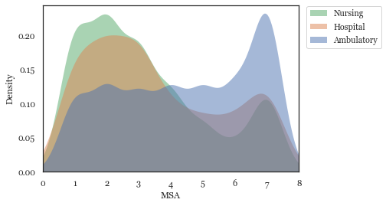
Comparing MSAs and Density: Finding 1
NAICS code 621: Ambulatory Health Care
Promise in each region having a similar density of about .12.
Poughkeepsie-Newburgh-Middletown, MSA 7, is showing a spike in ambulatory healthcare practices.
Booming market in MSA 7, potential for innovation and investment throughout the rest of New York State to keep up with these evolving practices.
Buffalo Rochester A-T-S Syr. Utica/Rome Bing. P-N-M

Slide 18
Comparing MSAs and Density: Finding 2
NAICS code 622: Hospitals
Dense in the Albany-Troy-Schenectady MSA, Rochester MSA, and the Buffalo MSA.
Companies like Clair Labs, specializing in at-home accessible care would thrive here.
Hospitals seem to drop off throughout the Syracuse MSA, Utica MSA, and the Binghamton MSA.
Spike back up near the Poughkeepsie-Newburgh-Middletown MSA.
To investors, these MSAs that are lacking or on the downward slope and potentially in need of innovation to bring the existing hospitals up to speed with the other areas.
Buffalo Rochester A-T-S Syr. Utica/Rome Bing. P-N-M

Slide 19
Comparing MSAs and Density: Finding 3
NAICS code 623: Nursing Facilities
The highest density is throughout the Rochester MSA. As previously mentioned, this MSA is a prime area right now for startups and sales dealing with the aging population.
Two other blossoming areas for startups and sales within the aging baby boomer population are Buffalo and Albany-Troy-Schenectady. These MSAs have similar densities behind the Rochester density.
Similar to hospitals, Syracuse, Utica, and Binghamton fall off when looking at the densities and the Poughkeepsie-Newburgh-Middletown MSA is on a slight rise.
Since these MSAs drop off in both hospitals and nursing and residential care facilities, these areas might be a better location for investment and innovation within ambulatory healthcare.
Buffalo Rochester A-T-S Syr. Utica/Rome Bing. P-N-M

Slide 20
Thank You &
Questions?
Research Questions?
sescacci@utica.edu
Join the Community
community.moregoodjobs.org
Next Presentation: Upstate Entrepreneurship Ecosystem Data Series
October 28 | 12-12:30 p.m.
Social Innovation in the Nonprofit Sector and Finding Similarities Through Data

